Slide 1
Dynamic calibration of the photoexcited lifetime in a GaAs double heterostructure
Tim Gfroerer, Olivia Guarinello, and Ben Votaw
Davidson College, Davidson, NC
Daniel Friedman
National Renewable Energy Laboratory, Golden, CO
Yong Zhang
University of North Carolina at Charlotte, Charlotte, NC

Slide 2
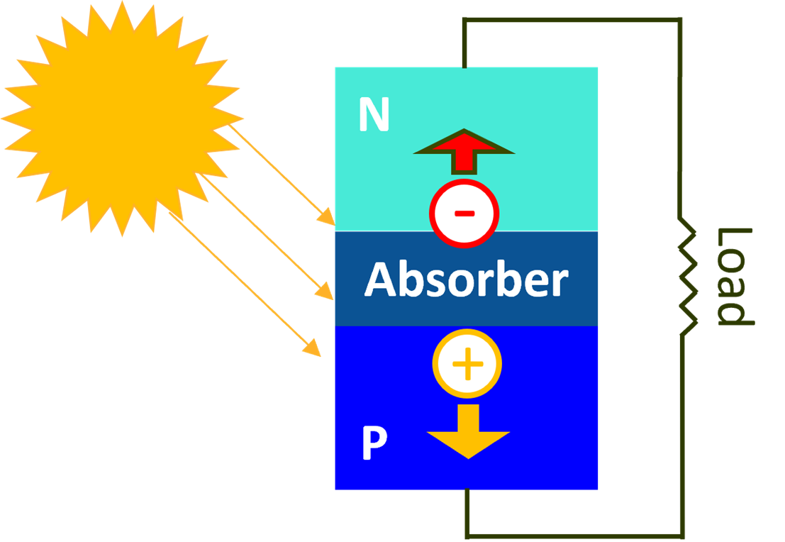
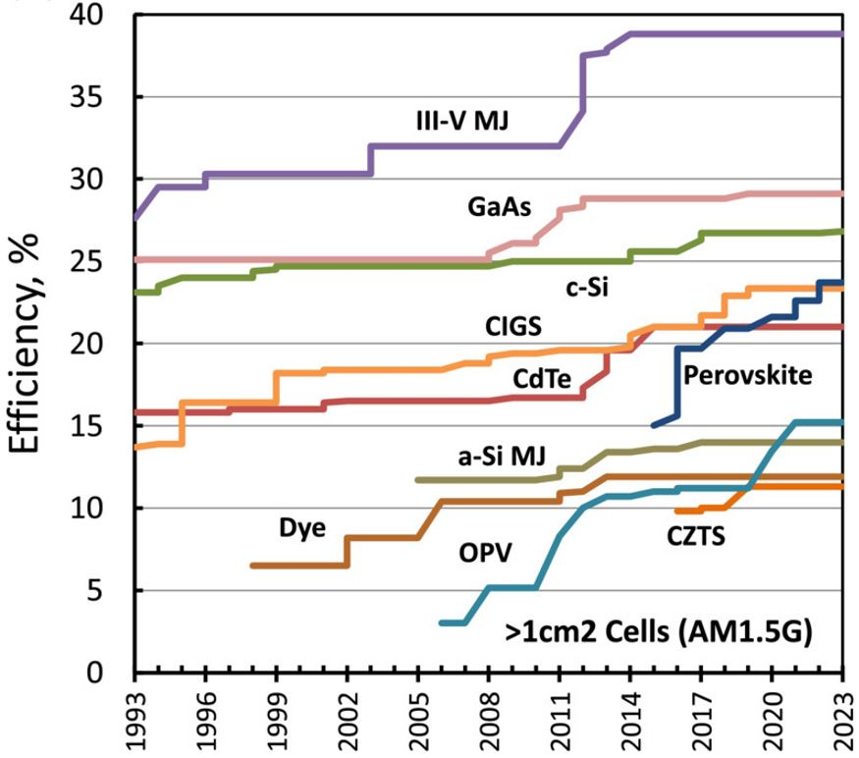
Motivation: Ultra-Efficient Single-Junction Photovoltaics
Solar Cell
Operation:
Convert excitation of electron-hole pairs (from sunlight) into electricity

Slide 3
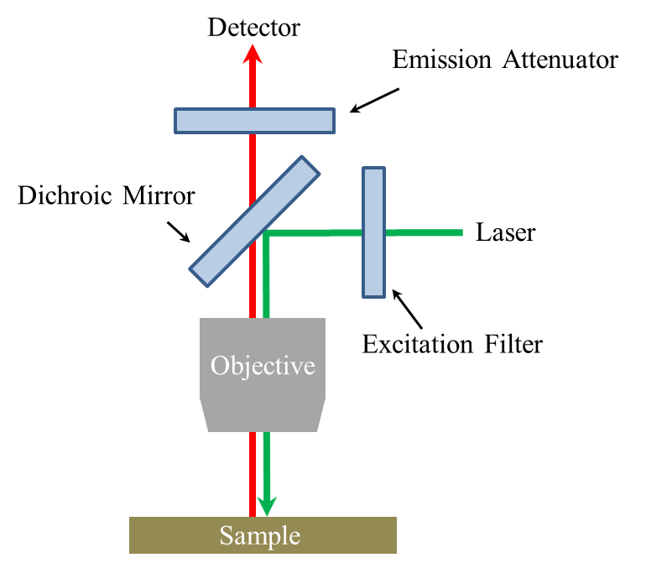
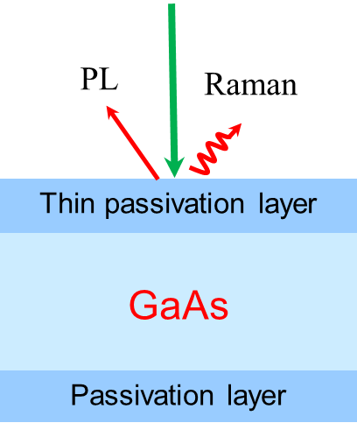
Prior Work: Steady-State Experiments
Confocal Photoluminescence/Raman
Reference: Zhang, et al. Light Sci. Appl. 11, 137 (2022).

Slide 4
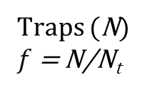






Prior Work: Steady-State Modeling
Conduction Band (n)
$$nc_{t}N_{t}\left(1−f\right)$$
Coupling Model
$$G$$
Traps (N)
$f$= N/N_{t}
$$\frac{dn}{dt}=G−W_{r}np−nc_{t}N_{t}\left(1−f\right)=0$$
$$W_{r}np$$
$$\frac{dN}{dt}=nc_{t}N_{t}\left(1−f\right)−fN_{t}W_{t}=0$$
$$fN_{t}W_{t}$$
Valence Band (p)

Slide 5
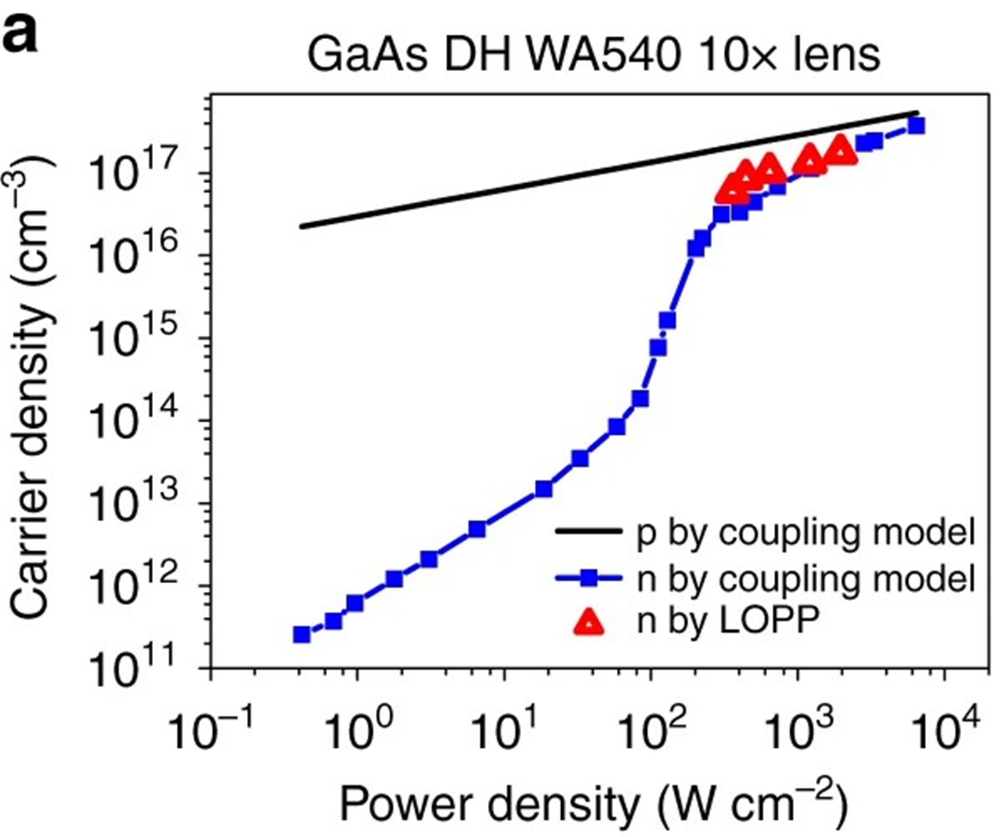
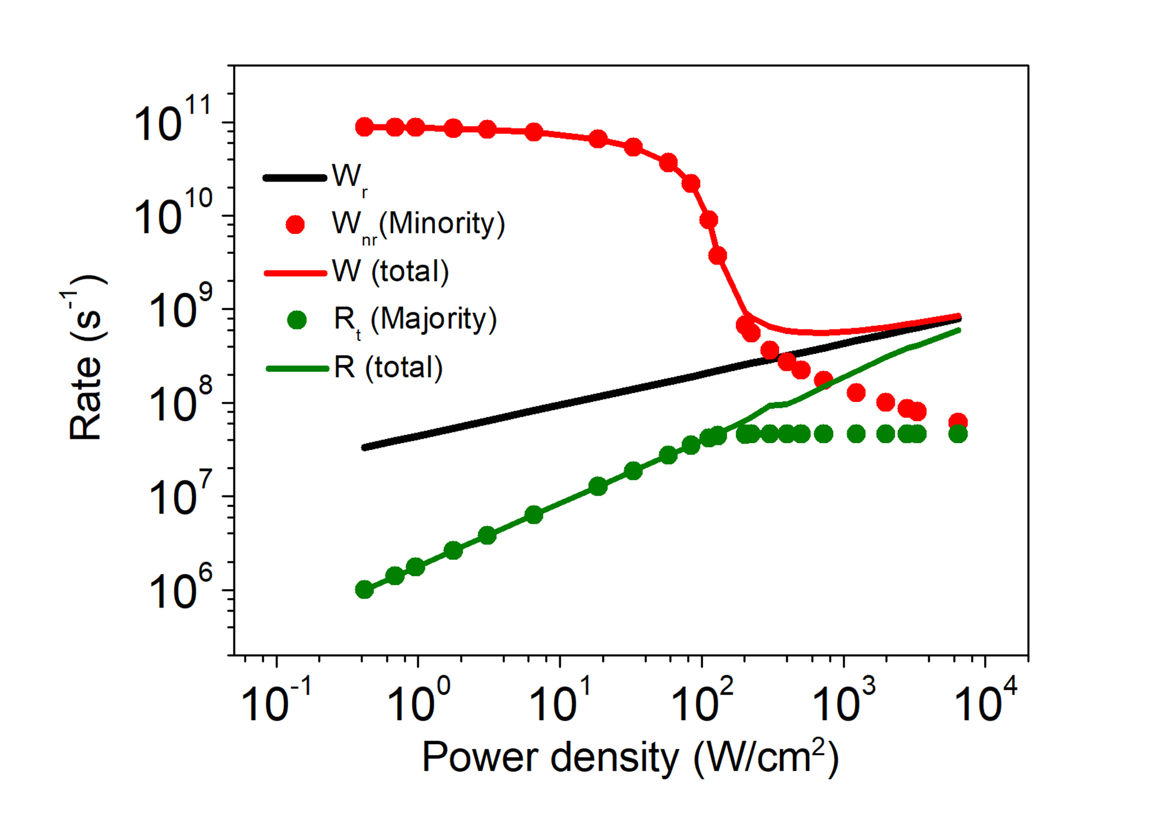
Prior Work: Steady-State Results

Slide 6
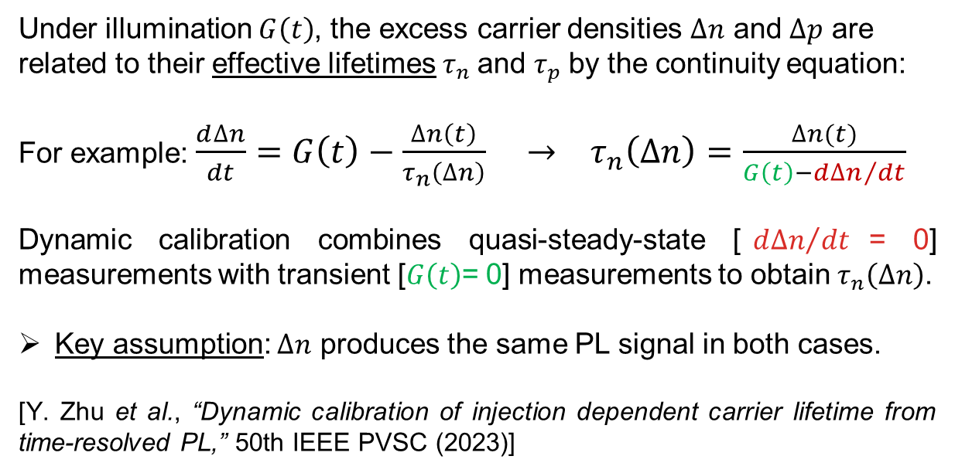
Testing: Dynamic Lifetime Calibration Method
Under illumination $G\left(t\right)$, the excess carrier densities $∆n$ and $∆p$ are related to their effective lifetimes${ τ}_{n}$ and $τ_{p}$by the continuity equation:
For example: $\frac{d∆n}{dt}=G\left(t\right)−\frac{∆n\left(t\right)}{τ_{n}\left(∆n\right)} → τ_{n}\left(∆n\right)=\frac{∆n(t)}{G\left(t\right)−{d∆n}/{dt}}$
Dynamic calibration combines quasi-steady-state [${d∆n}/{dt }$= 0] measurements with transient [$G\left(t\right)$= 0] measurements to obtain $τ_{n}\left(∆n\right)$.
Key assumption: $∆n$ produces the same PL signal in both cases.
[Y. Zhu et al., “Dynamic calibration of injection dependent carrier lifetime from time-resolved PL,” 50th IEEE PVSC (2023)]

Slide 7
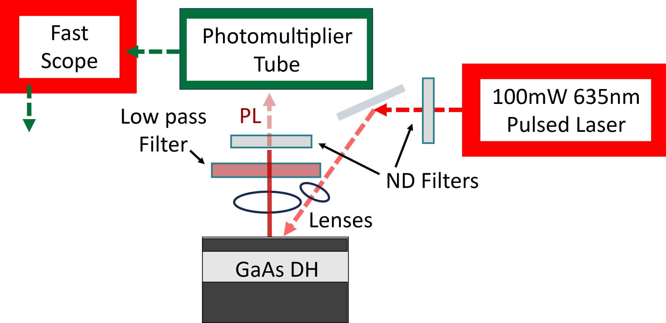
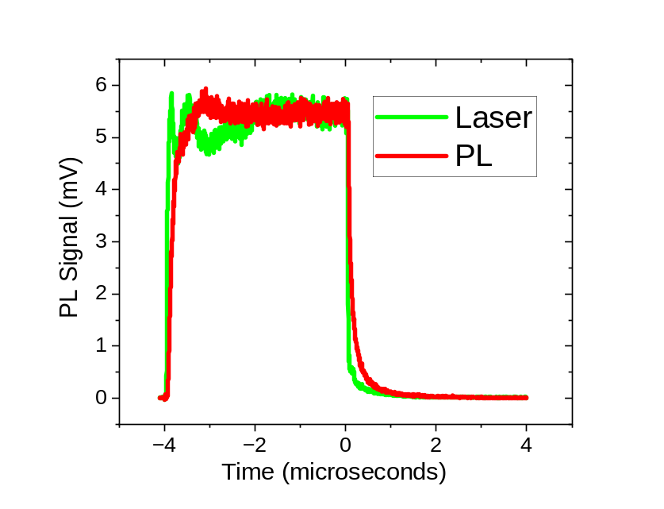
Dynamic Calibration Experiment

Slide 8
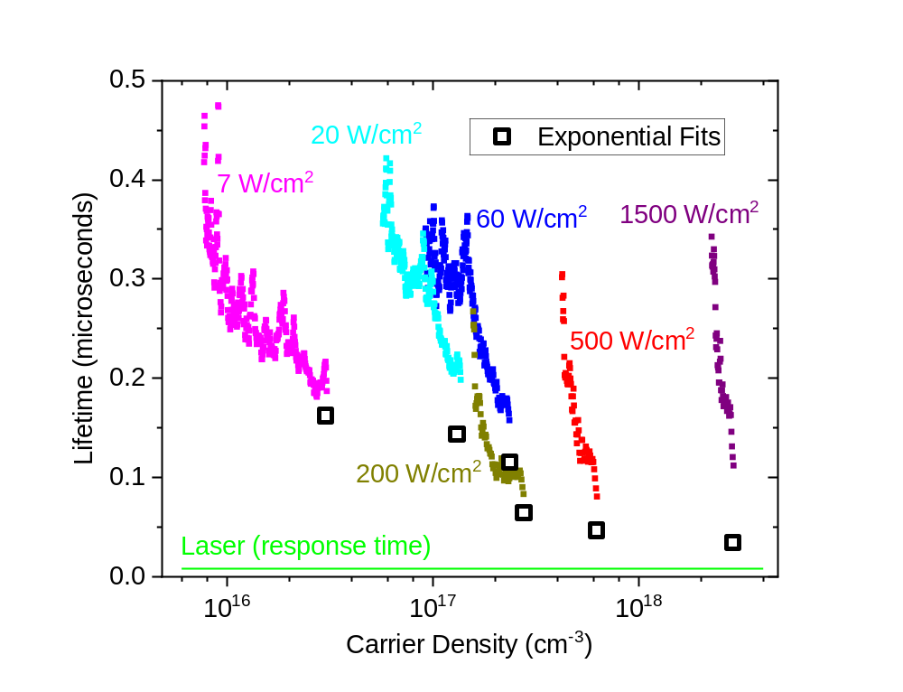
Calibration Results: Not Consistent …

Slide 9
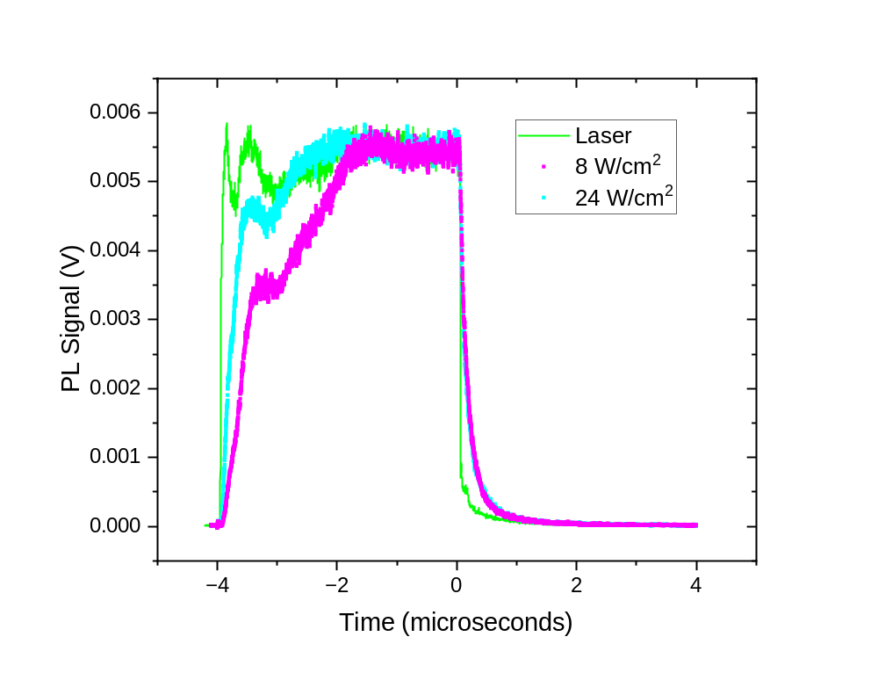
Unexpected Discovery: Very Slow Rise Times!

Slide 10
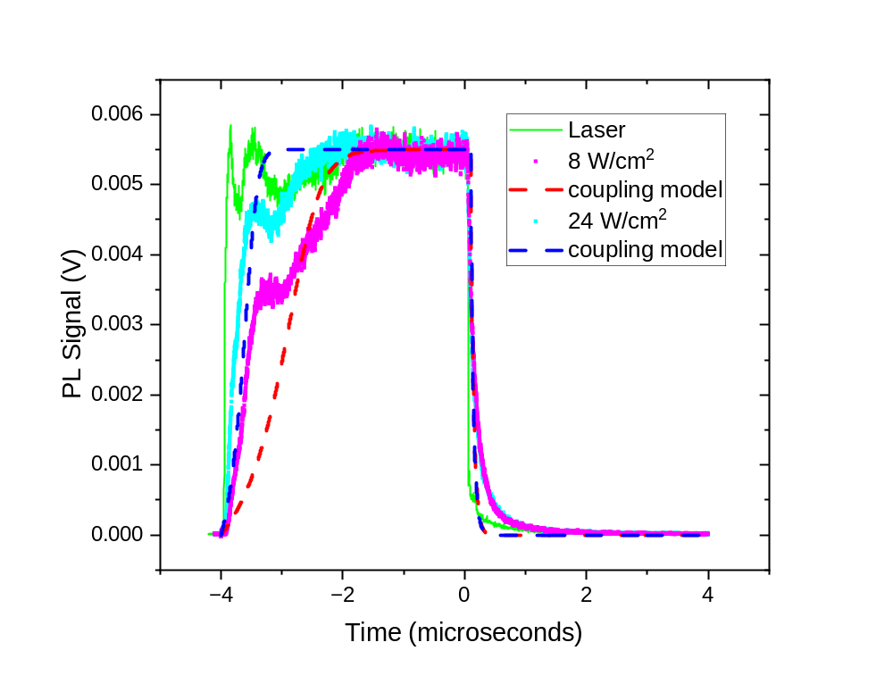
Unexpected Discovery: Slow Rise Times!
SS Parameters:
W_{r} = 10⁻⁹ cm³s⁻¹
c_{t} = 10¹¹ s⁻¹
N_{t} = 2 x 10¹⁷ cm⁻³
W_{t}= 10⁻¹⁰ cm³s⁻¹
Transient Parameters:
W_{r} = 10⁻¹⁰ cm³s⁻¹
c_{t} = 10⁸ s⁻¹
N_{t} = 2 x 10¹⁷ cm⁻³
W_{t}= 10⁻¹³ cm³s⁻¹

Slide 11
Conclusions and Future Work
Risetimes may be a better way to study trapping dynamics!
Fit full PL transients (rise and fall) to the Coupling Model to obtain optimal defect density, trapping, and recombination rates
Compare new transient parameters with prior steady-state results to identify and resolve discrepancies …
Thank you!

